Slide 1
Modelling direction detection in selected stocks in Indian BFSI sector
REVA Academy for Corporate Excellence (RACE)
Anand Mohan
SRN: R19MBA53
Date: 10/02/2023
MBA in Business Analytics
race.reva.edu.in

Slide 2

Introduction
Daily Trading NSE Data of HDFC, KOTAK, and SBI Bank from the year 2000 to 2022 is being used for this capstone project which would broadly come under BFSI.BFSI comprises of Banking, Financial Services, and Insurance sector. Also, the BFSI industry includes financial service firms such as Broking, and Asset Management. BFSI industry is growing year on year at 27% rate.
Conventionally, Fundamental analysis is used for evaluating a share's intrinsic value for long-term investment opportunities. Technical analysis evaluate trends, momentum, volume and volatility from a statistical perspective.
However, the consistency of the prediction performance of most of these techniques remains debatable and the volatility of the market is still unpredictable.
Therefore, investors aim to find better, easy, and simple Machine learning Modelling techniques for forecasting any share’s price to reduce volatility issues most optimally.

Slide 3
Literature Review
28 documents were reviewed for the purpose of capstone2.These included topics namely impact of algorithmic trading and Stock market prediction using machine learning techniques and analysis thereafter.
The effect of Technical and fundamental analysis on investment decisions were researched which included technical analysis for HDFC,KOTAK and SBI stocks.
supervised and unsupervised machine learning methods were gone through. Other studies included Decision tree for classification and regression, random forest algorithm, Logistic regression, XGBoost and KNN.
Effects of volatility, trend, momentum indicators for prediction of stock market were researched. Confusion matrix method of evaluation of error metrics were gone through.
Some of the research gaps observed were that Feature expansion and elimination techniques in data preparation were lacking details, fundamental analysis wasn't explored enough, research on volume indicators in technical analysis was missing. Hyperparameter tuning while discussing machine learning algorithms should have been discussed in more details.

Slide 4

Problem Statement
Business Problem | Analytics Solution
Try alternate approaches as well which enables us to decide objectively whether say the price of any stock will move up or move down or remain neutral.
Plenty of Regression algorithms to detect the closing price of any stock.
Underfitting and overfitting may destroy the accuracy of our regression models
completely relying only on regression algorithms to quantitatively predict the exact closing price of any stocks is not advisable.
Prediction Accuracy Still Unpredictable. Directional analysis is required.

Slide 5


Project Objectives
Explore the data and prepare the data to make it suitable to get utilized in Modelling algorithms.
Build the right models by using multiple Classification Modelling techniques .
minimize errors in direction prediction.
EDA
Feature Addition.
Get Right Stock.
Collect Relevant data
Logistic Regression
Decision Tree
Random Forest
k-Nearest Neighbours
Extreme Gradient Boosting
Given the historical data, it should be correctly predicted whether the price will move up or move down utilizing precision, recall and accuracy Metrics used in classification modelling techniques.

Slide 6

Project Methodology

Slide 7
Business Understanding
Stocks Technical Analysis
Stocks Fundamental Analysis
Technical Indicators | HDFC | KOTAK | SBI
RSI | 58.72 | 60.33 | 69.86
MACD | 18.97 | 25.42 | 14.07
Stochastic | 89.62 | 76.32 | 95.02
ADX | 11.43 | 37.66 | 30.53
ADX Upper Band | 1514.69 | 1970.16 | 582.40
ADX Lower Band | 1261.46 close price of HDFC stock is 1493.05 | 1854.60 close price of KOTAK stock is 1944.20 | 505.09 close price of SBI stock is 575.05
Particulars | HDFC | KOTAK | SBI
Promoters | 25.73% | 25.97% | 57.57%
Investors | 74.27% | 74.03% | 42.43%
Net Profit (Profit and Loss) | 36,961.36 | 8572.69 | 31,675.98
Adjusted EPS | 66.65 | 42.99 | 35.49
Total Liabilities (Balance Sheet) | 20.68, 535.05 | 4,29, 428.40 | 49,87, 597.41
Total Assets (Balance sheet) | 20,68, 535.05 | 4,29, 428.40 | 49,87, 597.41
Closing Cash (cashflow) | 155,386 | 52,665 | 398,905
All figures are in crores for the year 2022.

Slide 8
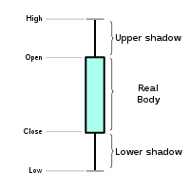
Data Understanding
Symbol | series | Prev Close | Open | High | Low | Last price | Close | VWAP | Vol
HDFC | EQ | 293.5 | 317 | 317 | 297 | 304 | 304.1 | 303.62 | 255251
HDFC | EQ | 304.05 | 290 | 303.9 | 285 | 295 | 292.8 | 294.53 | 269087
KOTAK | EQ | 229.35 | 247.7 | 247.7 | 225 | 247 | 246.9 | 244.12 | 73681
KOTAK | EQ | 246.95 | 229 | 240 | 227 | 228 | 228.4 | 233.75 | 105799
SBI | EQ | 243.65 | 243.6 | 262 | 238 | 258 | 259.1 | 251.46 | 4495 741
SBI | EQ | 259.1 | 249 | 264 | 245 | 249 | 248.5 | 252.35 | 3434 058
The previous close nearly always refers to the previous day's final price.
The last price is the one at which the foremost recent transaction happens.
volume-weighted average worth (VWAP) represents the typical price listed throughout the day,
based on both volume and worth.
Volume and Share turnover is an estimation of stock liquidity.

Slide 9
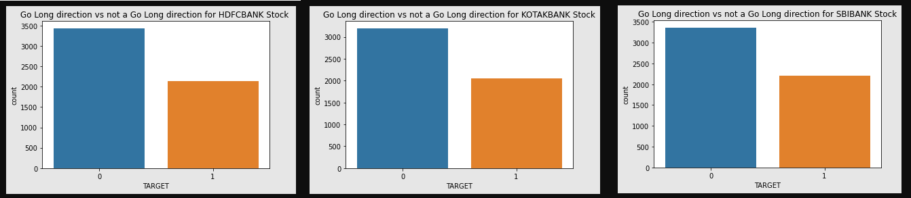
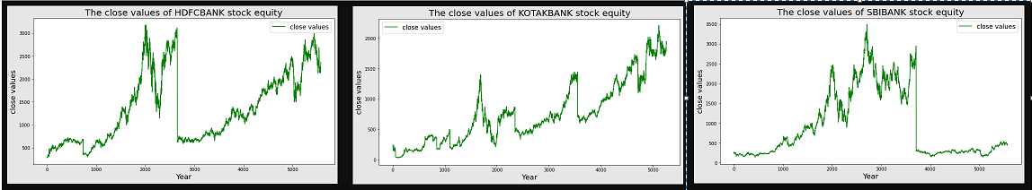
Data Understanding
class distribution For HDFC, KOTAK, and SBI stock
Close values of HDFCBANK, KOTAK BANK, and SBIBANK stock from 2000 to 2022

Slide 10
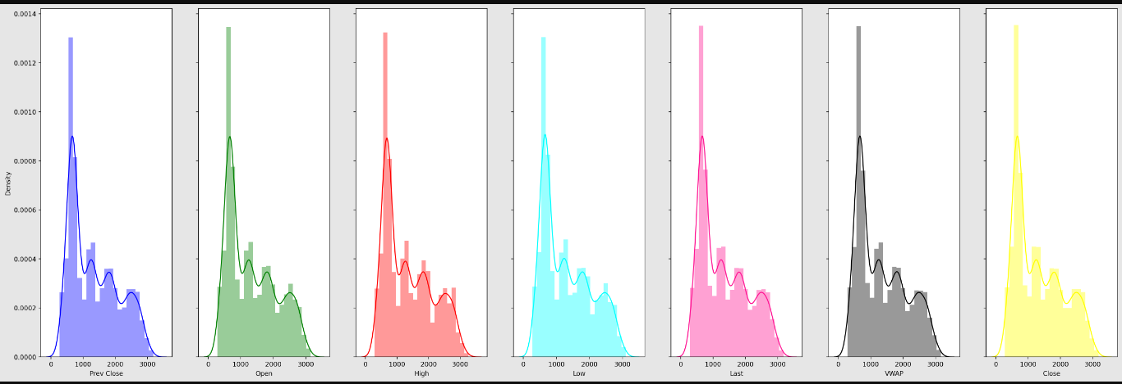
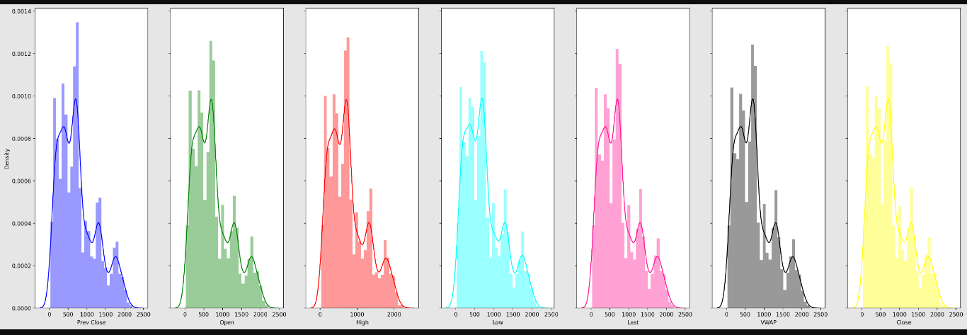
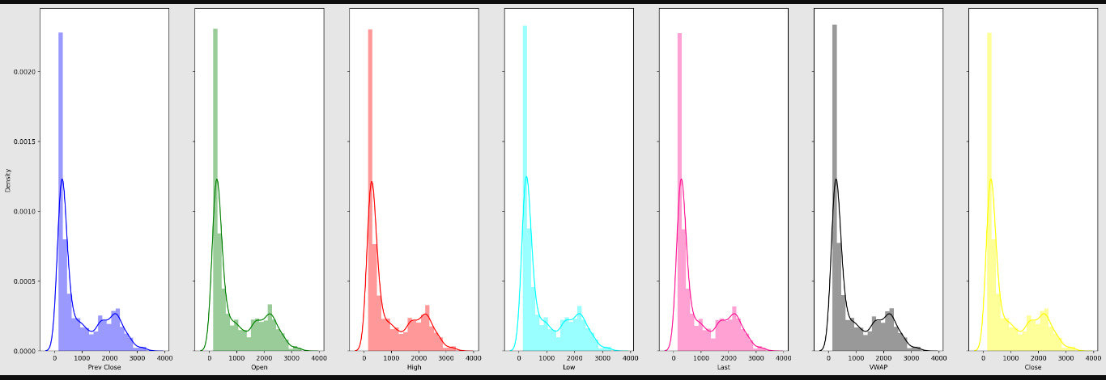
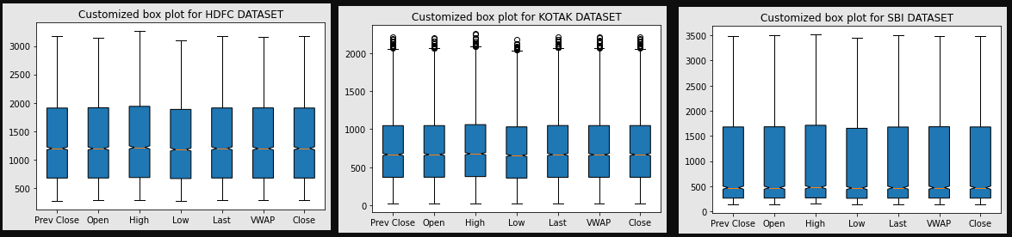
Data Understanding
Data Distribution plot of Feature variables and Close price for HDFC,KOTAK and SBI Stock shows Data has positive skewed distribution.
KOTAK has highest volatility followed by HDFC and then SBI.
HDFC Data Distribution
KOTAK Data Distribution
SBI Data Distribution
Box plots exhibits large difference between the 75th % tile and max values of most of the feature variables for all 3 stocks. Therefore, it suggests that there are extreme values Outliers in our data set.

Slide 11
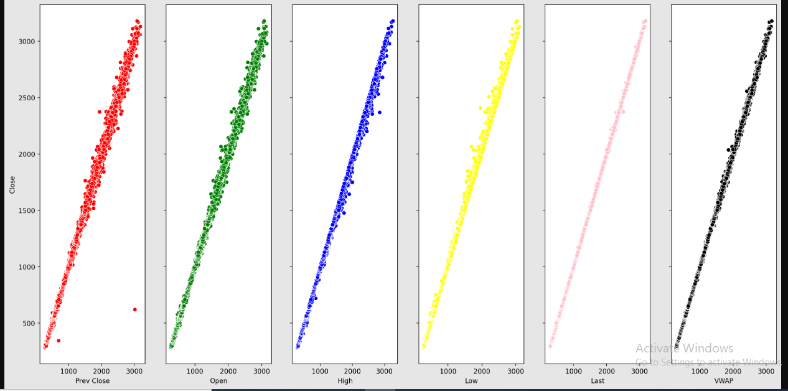
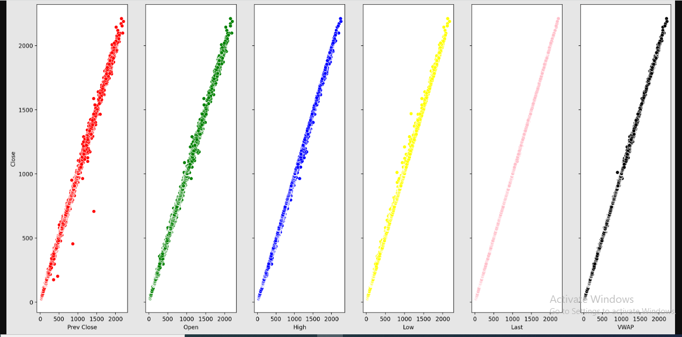
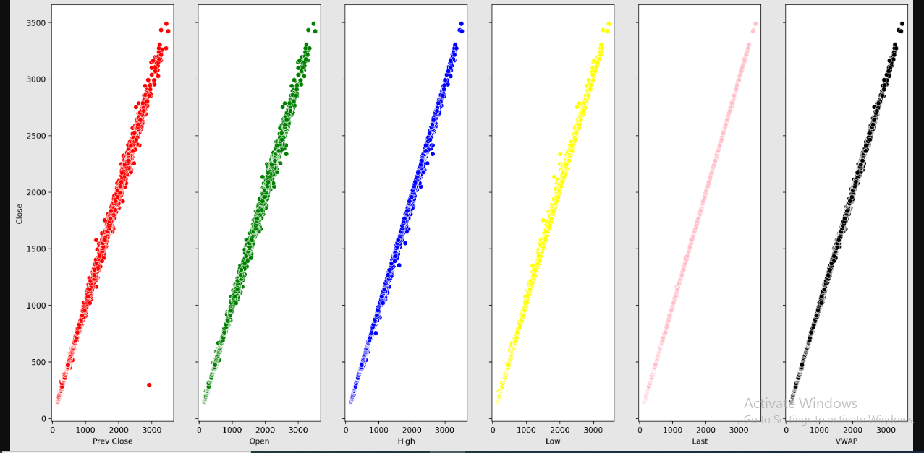
Data Understanding
Scatter Plot against close price for the HDFCBANK
Scatter Plot against close price for the KOTAKBANK
Scatter Plot against close price for the SBIBANK
It is observed that a linear relationship exists between Independent variables and the Target variable except for fewer outliers which is quite negligible.

Slide 12

Data Preparation
Missing Values | Feature Engineering
'Trades', 'Deliverable Volume', and'% Deliverable' had more than 100 missing values. Hence, those columns were dropped. | Newly Added Feature Variables: 13 days,20 days,100 days, 200 days Simple moving averages. exponential moving averages for 7 days,13 days,20 days,100 days, and 200 days. 1 day's previous lag values of volume. 6,10,14 and 30 days consecutive closing prices are tabulated week on week for the entire dataset . Momentum indicators Trend indicators Volatility indicators Volume indicators
MinMax Scaler shrinks the data inside the given range in this project i.e. from zero to one. It scales the price to a selected value range while not varying the form of the initial distribution.

Slide 13
Modeling
Modeling Techniques | Modeling Process | Model Building
Modelling Strategies | Model Evaluation Rule
Direction Detection by 6,10,14 days consecutive closing prices split week on the week. | percentage change on closing price>0.7% ➔Positive Trend percentage change on closing price<-0.7% ➔Negative Trend percentage change on closing price between 0.7 and 0.7% ➔Neutral
Go Long Direction Prediction performed separately using Momentum, Trend, Volatility and Volume Indicators | percentage change on closing price>0.5% ➔Positive Trend percentage change on closing price<=0.5% ➔Not Positive Trend
Classification Models used:
Logistic Regression
Decision Tree using Grid SearchCV and Cross Validation
Random Forest using Randomized SearchCV and Cross Validation
K Nearest Neighbours
XG Boost

Slide 14
Model Evaluation using LR Classifier
Modelling Strategies | HDFC | KOTAK | SBI
Direction Detection by 6,10,14 days consecutive closing prices split week on the week | precision-0.35 recall-0.60 accuracy-0.35 | Precision-0.37 recall-0.74 accuracy-0.36 | Precision-0.36 recall-1.00 accuracy-0.36
Go Long Direction Prediction using Volume Indicators | precision-0.98 recall-0.83 accuracy-0.92 | precision-0.99 recall-0.93 accuracy-0.97 | precision-0.92 recall-0.80 accuracy-0.90
Go Long Direction Prediction using Momentum Indicators | precision-0.71 recall-0.63 Accuracy-0.76 | precision-0.73 recall-0.61 accuracy-0.75 | precision-0.69 recall-0.62 accuracy-0.74
Go Long Direction Prediction using Trend Indicators | precision-0.83 recall-0.59 Accuracy-0.80 | precision-0.76 recall-0.48 accuracy-0.72 | precision-0.78 recall-0.49 accuracy-0.74
Go Long Direction Prediction using Volatility Indicators | precision-0.93 recall-0.47 Accuracy-0.77 | precision-0.90 recall-0.40 accuracy-0.74 | precision-0.81 recall-0.30 accuracy-0.70
Highest precision, recall and accuracy in direction prediction.

Slide 15
Model Evaluation using RF Classifier
Modelling Strategies | HDFC | KOTAK | SBI
Direction Detection by 6,10,14 days consecutive closing prices split week on the week | precision-0.85 recall-0.89 accuracy-0.87 | Precision-0.71 recall-0.79 accuracy-0.74 | Precision-0.83 recall-0.88 accuracy-0.85
Go Long Direction Prediction using Volume Indicators | precision-0.93 recall-0.69 accuracy-0.85 | precision-0.92 recall-0.79 accuracy-0.89 | precision-0.90 recall-0.73 accuracy-0.86
Go Long Direction Prediction using Momentum Indicators | precision-0.76 recall-0.51 Accuracy-0.75 | precision-0.78 recall-0.50 accuracy-0.75 | precision-0.72 recall-0.55 accuracy-0.74
Go Long Direction Prediction using Trend Indicators | precision-0.87 recall-0.56 Accuracy-0.80 | precision-0.85 recall-0.44 accuracy-0.74 | precision-0.83 recall-0.57 accuracy-0.78
Go Long Direction Prediction using Volatility Indicators | precision-0.92 recall-0.53 Accuracy-0.79 | precision-0.89 recall-0.50 accuracy-0.78 | precision-0.83 recall-0.61 accuracy-0.80
Highest precision, recall and accuracy in Direction Detection.
considerable precision and accuracy in direction prediction but recall can still be improved.

Slide 16
Model Evaluation using XG Boost Classifier
Modelling Strategies | HDFC | KOTAK | SBI
Direction Detection by 6,10,14 days consecutive closing prices split week on the week | precision-0.35 recall-0.42 accuracy-0.40 | Precision-0.38 recall-0.41 accuracy-0.40 | Precision-0.38 recall-0.47 accuracy-0.37
Go Long Direction Prediction using Volume Indicators | precision-0.90 recall-0.73 accuracy-0.86 | precision-0.92 recall-0.87 accuracy-0.92 | precision-0.88 recall-0.82 accuracy-0.89
Go Long Direction Prediction using Momentum Indicators | precision-0.70 recall-0.61 Accuracy-0.75 | precision-0.74 recall-0.59 accuracy-0.75 | precision-0.70 recall-0.59 accuracy-0.74
Go Long Direction Prediction using Trend Indicators | precision-0.85 recall-0.65 Accuracy-0.82 | precision-0.82 recall-0.61 accuracy-0.79 | precision-0.83 recall-0.67 accuracy-0.81
Go Long Direction Prediction using Volatility Indicators | precision-0.84 recall-0.69 Accuracy-0.82 | precision-0.81 recall-0.63 accuracy-0.79 | precision-0.80 recall-0.67 accuracy-0.81
considerable precision, recall and accuracy in direction prediction

Slide 17
Results and Insights
Key Findings | Suggestions
 | HDFC | KOTAK | SBI
Direction Detection by 6,10,14 days consecutive closing prices split week on the week (RF Classifier ) | precision-0.85 recall-0.89 accuracy-0.87 | Precision-0.71 recall-0.79 accuracy-0.74 | Precision-0.83 recall-0.88 accuracy-0.85
Go Long Direction Prediction using Volume Indicators (LR Classifier ) | precision-0.98 recall-0.83 accuracy-0.92 | precision-0.99 recall-0.93 accuracy-0.97 | precision-0.92 recall-0.80 accuracy-0.90
Go Long Direction Prediction using Momentum Indicators (LR Classifier ) | precision-0.71 recall-0.63 Accuracy-0.76 | precision-0.73 recall-0.61 accuracy-0.75 | precision-0.69 recall-0.62 accuracy-0.74
Go Long Direction Prediction using Trend Indicators (XG Boost Classifier ) | precision-0.85 recall-0.65 Accuracy-0.82 | precision-0.82 recall-0.61 accuracy-0.79 | precision-0.83 recall-0.67 accuracy-0.81
Go Long Direction Prediction using Volatility Indicators (XG Boost Classifier ) | precision-0.84 recall-0.69 Accuracy-0.82 | precision-0.81 recall-0.63 accuracy-0.79 | precision-0.80 recall-0.67 accuracy-0.81
RF classifier modelling has given the highest efficiency in Direction Detection.
LR Classifier provides best go long direction prediction
For a stop loss of 2.0 reward to risk ratio for approximate 0.8 Precision would be 2*.8/2*.2=4:1 if 0.5% difference in consecutive day close price for any stock is only 2.0.for higher percentage difference reward to risk ratio would be higher.

Slide 18
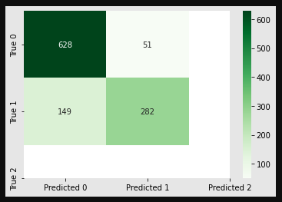
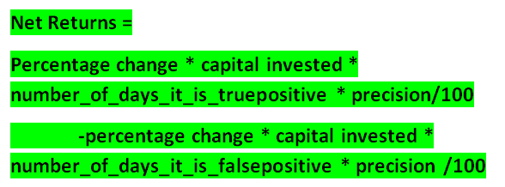
Utility from the Business perspectives
Key Findings | Suggestions
Go Long Direction Prediction:
Using Trend Indicators with the highest precision of 0.85 for HDFCBANK stock, the confusion matrix provides information as shown.
If we invest Rs.10000 for 6 years and roughly calculate profit with 0.5% change on close price with the highest precision in detecting true positives
Net Returns will be:
0.5*10000*282*0.85/100-0.5*10000*51*0.85/100=
Rs. 9817.5 profit which would be
9817.5 / (10000*6)*100=16.36% returns.

Slide 19
Risk-Adjusted Returns
Key Findings | Suggestions
The Real Data dump is imported for HDFC, KOTAK, and SBI stock between 2000 till 2022. Then the Return, Variance, and Volatility of these stocks are calculated following which the Annualized return to Risk ratio and finally, the Sharpe ratios are calculated.
The Sharpe ratio for HDFCBANK Stock is calculated as 0.173818.
The Sharpe ratio for KOTAK BANK Stock is calculated as 0.149589.
The Sharpe ratio for SBIBANK Stock is calculated as 0.005306.
Therefore, from the results obtained it becomes evident that HFDC shows a better Return vs. Risk performance over the specified period compared to KOTAK stock followed by the SBI stock which shows the least Return vs. Risk performance.

Slide 20


Model Deployment
Demonstration
As per the proposal for future assignments, the dashboard takes API as an input Derived from the machine/deep learning algorithms for multi-label features with an end-to-end UI Interface.

Slide 21

Conclusion and Future Work
Any stock on the stock market can utilize the same procedure as defined in this project to forecast buy or sell choices, which is helpful.
Intelligent Automated system on Options Trading would be the next step forward.
In the Future, there is a deployment Dashboard proposed.
In future projects, it can be shown how to define Bullish and Bearish regimes using modern machine learning techniques.
The Sentiment Analysis Approach may also be explored using Text Analytics for predicting stock market returns.

Slide 22
References
Bibliography | Webliography
Al-Bairmani, Z. A. A., & Ismael, A. A. (2021). Using Logistic Regression Model to Study the Most Important Factors Which Affects Diabetes for the Elderly in the City of Hilla / 2019. Journal of Physics: Conference Series, 1818(1). https://doi.org/10.1088/1742-6596/1818/1/012016
Alhomadi, A. (2021). Forecasting stock market prices : A machine learning approach. Digital Commons, 11(2), 16–36.
Anjani, T., & Syarif, A. D. (2019). The Effect of Fundamental Analysis on Stock Returns using Data Panels ; Evidence Pharmaceutical Companies listed on IDX. International Journal of Innovate Science and Research Technology, 4(7), 500–505.
Cornellius Yudha Wijaya. (2021). CRISP-DM Methodology For Your First Data Science Project. https://towardsdatascience.com/crisp-dm-methodology-for-your-first-data-science-project-769f35e0346c
Dahham, A. Z. D., & Ibrahim, A. A. (2020). Effects of Volatility and Trend Indicator for Improving Price Prediction of Cryptocurrency. IOP Conference Series: Materials Science and Engineering, 928(3). https://doi.org/10.1088/1757-899X/928/3/032043
Dar, A. N. (2021). PRINCIPAL COMPONENT ANALYSIS (PCA) (Using Eigen Decomposition). Gsj, 9(7), 240–252. www.globalscientificjournal.com
Elbialy, B. A. (2019). The Effect of Using Technical and Fundamental Analysis on the Effectiveness of Investment Decisions of Traders on the Egyptian Stock Exchange. International Journal of Applied Engineering Research, 14(24), 4492–4501. http://www.ripublication.com
Faijareon, C., & Sornil, O. (2019). Evolving and combining technical indicators to generate trading strategies. Journal of Physics: Conference Series, 1195(1). https://doi.org/10.1088/1742-6596/1195/1/012010
Hafeez, M. A., Rashid, M., Tariq, H., Abideen, Z. U., Alotaibi, S. S., & Sinky, M. H. (2021). Performance improvement of decision tree: A robust classifier using tabu search algorithm. Applied Sciences (Switzerland), 11(15). https://doi.org/10.3390/app11156728
Hansen, K. B. (2020). The virtue of simplicity: On machine learning models in algorithmic trading. Big Data and Society, 7(1). https://doi.org/10.1177/2053951720926558
Huang, Y., Capretz, L. F., & Ho, D. (2021). Machine Learning for Stock Prediction Based on Fundamental Analysis. 2021 IEEE Symposium Series on Computational Intelligence, SSCI
2021 - Proceedings. https://doi.org/10.1109/SSCI50451.2021.9660134
Jena, M., & Dehuri, S. (2020). Decision tree for classification and regression: A state-of-the art review. Informatica (Slovenia), 44(4), 405–420. https://doi.org/10.31449/INF.V44I4.3023
Kimbonguila, A., Matos, L., Petit, J., Scher, J., & Nzikou, J.-M. (2019). Effect of Physical Treatment on the Physicochemical, Rheological and Functional Properties of Yam Meal of the Cultivar “Ngumvu” From Dioscorea Alata L. of Congo. International Journal of Recent Scientific Research, 10, 30693–30695. https://doi.org/10.24327/IJRSR
Magner, N., Lavin, J. F., Valle, M., & Hardy, N. (2021). The predictive power of stock market’s expectations volatility: A financial synchronization phenomenon. PLoS ONE, 16(5 May), 1–21. https://doi.org/10.1371/journal.pone.0250846
Markoulidakis, I., Kopsiaftis, G., Rallis, I., & Georgoulas, I. (2021). Multi-Class Confusion Matrix Reduction method and its application on Net Promoter Score classification problem. ACM International Conference Proceeding Series, 412–419. https://doi.org/10.1145/3453892.3461323
Mohapatra, S., & Misra, A. K. (2020). Momentum returns: A portfolio-based empirical study to establish evidence, factors and profitability in Indian stock market. IIMB Management Review, 32(1), 75–84. https://doi.org/10.1016/j.iimb.2019.07.007
moneycontrol. (n.d.). HDFC Bank Ltd.TECHNICALS. https://www.moneycontrol.com/technical-analysis/hdfcbank/HDF01/weekly
Mukerji, P., Chung, C., Walsh, T., & Xiong, B. (2019). The Impact of Algorithmic Trading in a Simulated Asset Market. Journal of Risk and Financial Management, 12(2), 68. https://doi.org/10.3390/jrfm12020068
Omta, W. A., van Heesbeen, R. G., Shen, I., de Nobel, J., Robers, D., van der Velden, L. M., Medema, R. H., Siebes, A. P. J. M., Feelders, A. J., Brinkkemper, S., Klumperman, J. S., Spruit, M. R., Brinkhuis, M. J. S., & Egan, D. A. (2020). Combining Supervised and Unsupervised Machine Learning Methods for Phenotypic Functional Genomics Screening. SLAS Discovery, 25(6), 655–664. https://doi.org/10.1177/2472555220919345
Rajkar, A., Kumaria, A., Raut, A., & Kulkarni, N. (2021). Stock Market Price Prediction and Analysis. International Journal of Engineering Research & Technology, 10(06), 115–119.
Rouf, N., Malik, M. B., Arif, T., Sharma, S., Singh, S., Aich, S., & Kim, H. C. (2021). Stock
market prediction using machine learning techniques: A decade survey on methodologies, recent developments, and future directions. Electronics (Switzerland), 10(21). https://doi.org/10.3390/electronics10212717
Schonlau, M., & Zou, R. Y. (2020). The random forest algorithm for statistical learning. Stata Journal, 20(1), 3–29. https://doi.org/10.1177/1536867X20909688
Shah, D., Isah, H., & Zulkernine, F. (2019). Stock market analysis: A review and taxonomy of prediction techniques. International Journal of Financial Studies, 7(2). https://doi.org/10.3390/ijfs7020026
Silva, I., & Naranjo, J. E. (2020). A systematic methodology to evaluate prediction models for driving style classification. Sensors (Switzerland), 20(6), 1–21. https://doi.org/10.3390/s20061692
Sonkiya, P., Bajpai, V., & Bansal, A. (2021). Stock price prediction using BERT and GAN. http://arxiv.org/abs/2107.09055
Thanekar, G. S., & Shaikh, Z. S. (2021). Analysis and Evaluation of Technical Indicators for Prediction of Stock Market. International Journal of Engineering Research & Technology (IJERT), 10(May), 341–344.
Wang, L. (2019). Research and Implementation of Machine Learning Classifier Based on KNN. IOP Conference Series: Materials Science and Engineering, 677(5), 0–5. https://doi.org/10.1088/1757-899X/677/5/052038
Zhang, P., Jia, Y., & Shang, Y. (2022). Research and application of XGBoost in imbalanced data. International Journal of Distributed Sensor Networks, 18(6). https://doi.org/10.1177/15501329221106935

Slide 23

Annexure
Publications | Conferences
The implementation for the capstone project can be accessed at the link below:
https://github.com/Embedded-org/ACCOMPLISHMENTS/tree/master/RACE_CAPSTONE_PROJECT2
The implementation document for the capstone project can be accessed at the link below:
https://github.com/Embedded-org/ACCOMPLISHMENTS/blob/master/RACE_CAPSTONE_PROJECT2/Capstone2_implementation.docx

Slide 24


